Slide 1
Distressed and Distressing Students
The UCLA Consultation & Response Team
UCLA Counseling & Psychological Services
Notes:
Introduce yourself, your role at CAPS, a personal connection to campus (if any)

Slide 2
Goals for the presentation
Review common signs of distress
How to respond to distress
  CAPS information & how to refer
  CRT information & how to refer
How to Defuse and De-Escalate
Circumstances that indicate emergency services
  Red Folder
Notes:
Explain the presentation is intended to be interactive, so encourage the audience to ask questions or share examples when relevant

Slide 3

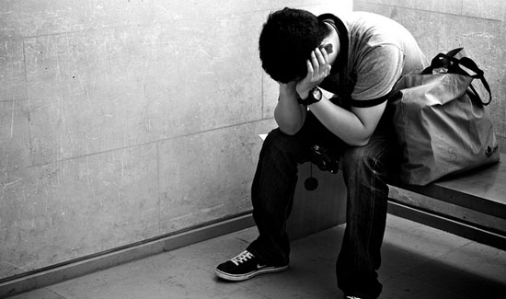
Students in Distress
Common Signs
Notes:
Want to familiarize audience w/common signs of distress in order to be able to identify students who are distressed or distressing;
set the tone for the rest of the presentation and gain a general understanding that no student will fit all signs, but that they should trust their instincts and if they are concerned reach out and connect the student

Slide 4


Signs of Distress:
Cognitive Impairments
Inappropriate, bizarre or strange behavior
Extreme emotionality
Agitation, intense restlessness, hyperactivity
Impairment of attention and memory
Impaired speech or disjointed, confused thoughts
Paranoia or suspiciousness

Slide 5


Signs of Distress:
Behavioral Disturbances
Decline in personal hygiene
Consistent disheveled or fatigued appearance
Lethargy, lack of energy, falling asleep in class
Disruptive classroom behavior
Aggressive, angry or threatening behavior
Dramatic weight loss or gain
Obvious use of mood-altering substances

Slide 6


Stress Signs:
References to Self Harm or Suicide
Overt references to suicide -- orally or in writing
Expressions of helplessness or hopelessness
Isolation from friends and family
Pessimistic feelings about the future
Giving away valuable or prized possessions
Preparing for death (will; memorial preferences)

Slide 7
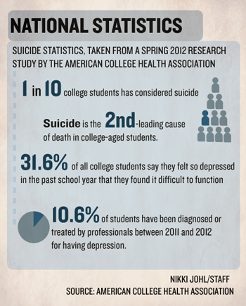
Notes:
Lead: CAPS
Take any and all signs of suicide or suicidal ideation seriously- some students may express ideation via academic work (assignments, emails w/TAs, reasons for missing exams)
If interested in learning more on how to intervene with SI, can participate in CAPS QPR Suicide Gatekeeper Training which is offered quarterly to all students and staff- go to CAPS website for more information

Slide 8
Common barriers to seeking help
  Lack of knowledge about services
  Stigma and shame
  History of being underserved due to systemic barriers to care (in low SES, religious minorities, immigrants, LGBTQ, persons with disabilities, international students, etc.)
  Cultural factors
    I am used to dealing with issues on my own
    Getting help is a sign of weakness
    They won’t understand my issues
    Norms of masculinity
  Financial concerns
  Physical barriers: accessibility
Notes:
Barriers to care can include: stigma, discrimination, lack of culturally sensitive services, location, poor quality of services offered, cost, lack of insurance coverage, mistrust in services (e.g. in undocumented students), etc.
Lack of knowledge about services (what is available, what we do, cost, hours)
Stigma and shame (I am not crazy, people may see me in the building)
History of being underserved due to systemic barriers to care (in low SES, religious minorities, immigrants, LGBTQ, persons with disabilities, international students, etc.)
Cultural factors
I am used to dealing with issues on my own
Getting help is a sign of weakness
They won’t understand my issues
Norms of masculinity
Financial concerns
Physical barriers: accessibility
Address barriers honestly and realistically:
1 in 6 students use our services
Students seek help for a range of issues, from adjustments to new environments to serious mental illness
SHIP pays for the services; if non SHIP, we help them get connected to providers using their insurance
It is common to feel embarrassed but we can go together, etc…
Services are confidential, not part of a student’s record
Mental health is essential to overall health, and can help with academic performance
CAPS strives to consider cultural sensitivity, diversity in staff

Slide 9


Responding to Distress
Early feedback, intervention and appropriate referral can prevent more serious problems from developing

Slide 10
Communicating with Us
 | CAPS | CAPS and Case Managers | Case Managers
Consultation |  | Consults w/staff, faculty, students, and parents
Confidentiality | Information remains privacy-protected |  | Information protected by FERPA
Outreach |  | Contacts students to offer assistance
Records | Confidential records of all communication regarding students |  | FERPA protected records
Notes:
Lead: CAPS and Case Manager.
Providing updated information about a concerning student is ALWAYS welcome. Your concerns are our concerns.
Provide information on confidentiality- cannot confirm/deny student is in tx but information can be helpful if student is already being seen at CAPS

Slide 11
Consultation & Response Team (CRT)
Multidisciplinary Team created in 2006
Focused on responding to reports of students in distress and students of concern
Threat assessment in collaboration with UCPD
Email: CRTeam@ucla.edu
Phone: 310-825-7291
Website: www.studentincrisis.ucla.edu

Slide 12
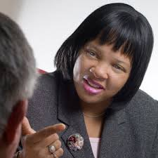

UCLA Case Managers
The Case Managers can assist with the following:
Academic support including notifying professors regarding missed classes, dropping a class, withdrawal, etc.
Referrals to campus and community resources
Consultation for the university community regarding students in distress
Contact information for the Case Managers:
All Case Managers can be reached by emailing CRTeam@ucla.edu.

Slide 13

Consult with CRT Case Managers
Signs of Cognitive Impairments (mentioned earlier)
Decline academic performance
Making disturbing comments in conversation, email, letters, social media postings or papers
Struggling with health, finances, or family problems
Thoughts of harm to self or others (suicidal ideation)
When in doubt, reach out!

Slide 14

Communicating with CAPS
CAPS consults with faculty, staff, students & parents
  All information remains privacy-protected
CAPS maintains confidential electronic records of all communications regarding students
Providing updated information about a concerning student is ALWAYS welcome. Your concerns are our concerns.

Slide 15

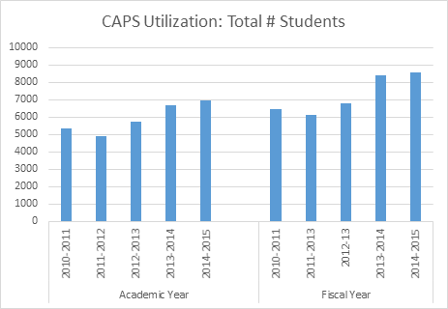
Snapshot of
Notes:
This is sometimes the best thing you can say to someone who is unsure about coming to CAPS as it normalizes the experience.
Increased utilization over the past several years- why that might be
2014-2015 academic year -> 6964 students seen at CAPS

Slide 16
Referring a Student to CAPS
Offer details on how to access CAPS services
Offer to accompany the student to CAPS
Call CAPS for a consultation with a CAPS Clinical Coordinator
Notes:
CAPS
Many community members call and consult w/CAPS re: how to intervene w/a student of concern and will have CAPS outreach to students of concern on their behalf- this can often help a student connect to CAPS if any barriers are present, potential for sooner appt time, often able to get students access to our services and other resources
Ask audience members if they have ever successfully referred to CAPS and if so what they did that worked? How did they feel about it? What would increase someone’s comfort to refer to CAPS- welcome them to stop by CAPS and check it out

Slide 17
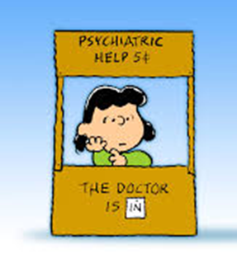
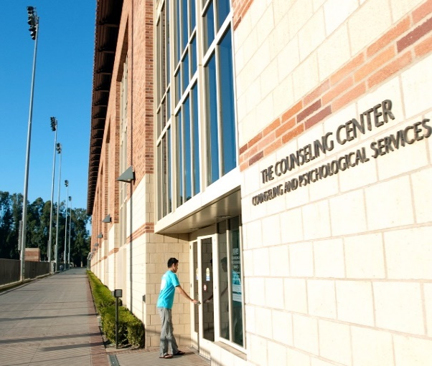
CAPS Services
  Individual Counseling
  Couples Counseling
  Psychiatric Consultation & Medication
  Group Therapy
  Alcohol & Substance Screening & Brief Intervention
  Workshops, Training & Web Resources
  CARE: Sexual assault services/reporting
  UCLA CAPS 24-Hour hotline
  (310) 825-0768

Slide 18
Supporting
Students of Concern
When in doubt, reach out!
Don’t ignore strange or inappropriate behavior -- respond to it
Be direct & matter of fact about what you’ve observed
Listen, refer, document, report.
Contact CRT if you intuitively feel like the student needs help.
Know your limits. Keep in mind what your role is in working with students. Trained professionals are available to help.
Consult with CAPS or a CRT Case Manager for tips on making a referral
Notes:
Lead: Case Manager
Keep in mind their boundaries and what they may or may not feel comfortable with, every one is different, can involve other TAs or their faculty member if they are not comfortable with intervening w/the student of concern
In line w/boundaries, keep in mind your role to the students and try not to take this on all on your own- involving CRT, CAPS and other supports for this student will be best for both you and the student- you are not a licensed clinician
Stating observations is always best, vs labeling their bx’s
Indicate there is a spectrum of severity in discussing students of concern, therefore interventions will defer based on how severe each case is- trust instincts and if they feel unsafe involve emergency services (UCPD)

Slide 19
FAQs

Slide 20
How to Defuse and De-Escalate
A Hostile Person May be Communicating:
Vulnerability
Confusion
Overload of Emotional Stress
Fear
Feelings of Helplessness
Powerlessness
Notes:
Lead: CAPS
Try to get audience members to empathize with students they are approaching who are distressing- if they can see fear, confusion or helplessness may be more willing to engage w/and intervene w/the student- but remind not to intervene if safety is a concern

Slide 21
How to Diffuse an Angry Interaction
Assume the student has a right to be angry
Own the part of the problem that is yours
Person First, Problem Second
Encourage the student to talk; listen closely and patiently
Convey an understanding of their situation
ALIGN with the student
  Acknowledge the student’s feelings
  Identify & acknowledge what the student wants that he/she isn’t getting
Seek help if the student concerns seem not attached to reality
Notes:
Lead: CAPS
Case by case basis on how best to intervene, but helpful to empathize w/students, validate and understand their concerns in order to get them connected
Some students may be in so much distress or may make you feel unsafe, and that is not when we want to focus on problem solving but redirect to emergency services and trust your instincts

Slide 22
Defusing an Escalating Situation
Unless there is imminent risk, slow down & assess first
Reduce stimulation from the setting (move to private space)
Try to protect the individual’s self esteem vs. responses that increase shame and rage
Communicate information about the process
Provide choices; break big problems into smaller ones
Work toward outlining concrete next steps to resolving a conflict
Use appropriate limit setting
Notes:
Lead: Case Manager
Moving to a more private space can sometimes help de-escalate a situation, however you should never meet w/a student alone if you feel any issues related to safety- keeping the door open, having another staff member join the meeting as support, do not meet w/student privately if these concerns arise
Communicating information about the process is related to being transparent- telling students steps you are taking to address theirs or your concerns, including letting them know you are calling CAPS and can do so together, or will seek consultation from CRT who may reach out to students, etc
Appropriate limit setting often means that you are not alone in knowing this students distress or concerns, always connecting to more supports and getting support from your dept to better intervene with the student

Slide 23
Consultation & Response Team Contact
Email: CRTeam@ucla.edu
Phone: 310-825-7291
Website: www.studentincrisis.ucla.edu
Notes:
Lead: Case Manager

Slide 24
Call UCPD
(310) 825-1491 or 911
Threats of harm to self or others
Preoccupation with violence or persons who have engaged in violence
Preoccupation with weapons, especially combined with access to weapons
Mentioning plans for a violent or destructive event
Emergency situations
Notes:
Lead: Case Manager

Slide 25
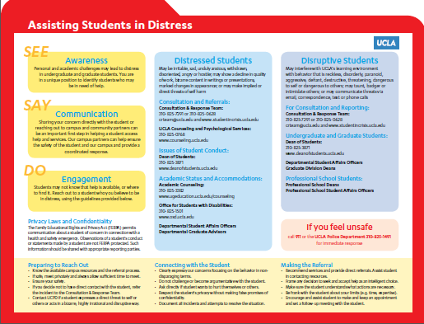
Notes:
Lead: Case Manager

Slide 26
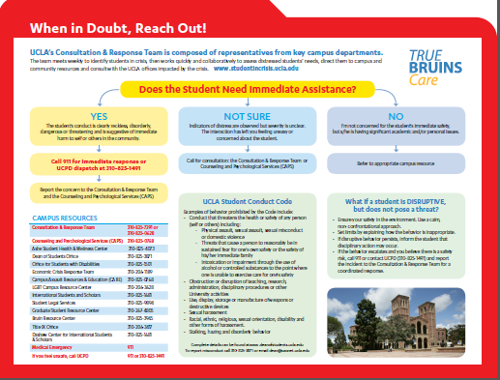
Notes:
Lead: Case Manager

Slide 27

Resources
For immediate, life-threatening emergencies on campus, call the UCPD 310-825-1491 or 911
CSO escorts (310) 794-WALK
UCLA Staff and Faculty Counseling Center (310) 794-0245
UCLA Behavioral Intervention Team (310) 794-0422

Slide 28

Thank you!
Emily Harris
CRT
310-405-5303
Ana Ribas
CAPS
310-825-0768

